Slide 1


Understanding Mass Shootings Through Data
Uncovering Patterns and Insights
Notes:
Hello. I’m Sammi Beard, and I want to take you on a journey that explores the patterns behind mass shootings and how data can help us better understand them.

Slide 2

The Human Impact
Notes:
Before we dive into the data, it's important to pause and recognize the human impact. These numbers represent real individuals—families, communities, and lives that were lost or forever altered. The data reflects 2,210 lives tragically taken and 1,438 others injured in these attacks. While our focus is on analyzing the perpetrators, we must remember that the consequences of these actions have left lasting scars on the victims and their families.

Slide 3
The Questions
What patterns exist in mass shootings?
Are there common warning signs?
Can we use data to predict and prevent these events?
Notes:
These are the questions that drove my research. We often hear theories, but I wanted to see what the data actually tells us. o answer these questions, I worked with a dataset containing hundreds of incidents, capturing demographics, criminal history, mental health, and other key details. But data isn’t perfect—so let’s look at what we found.

Slide 4
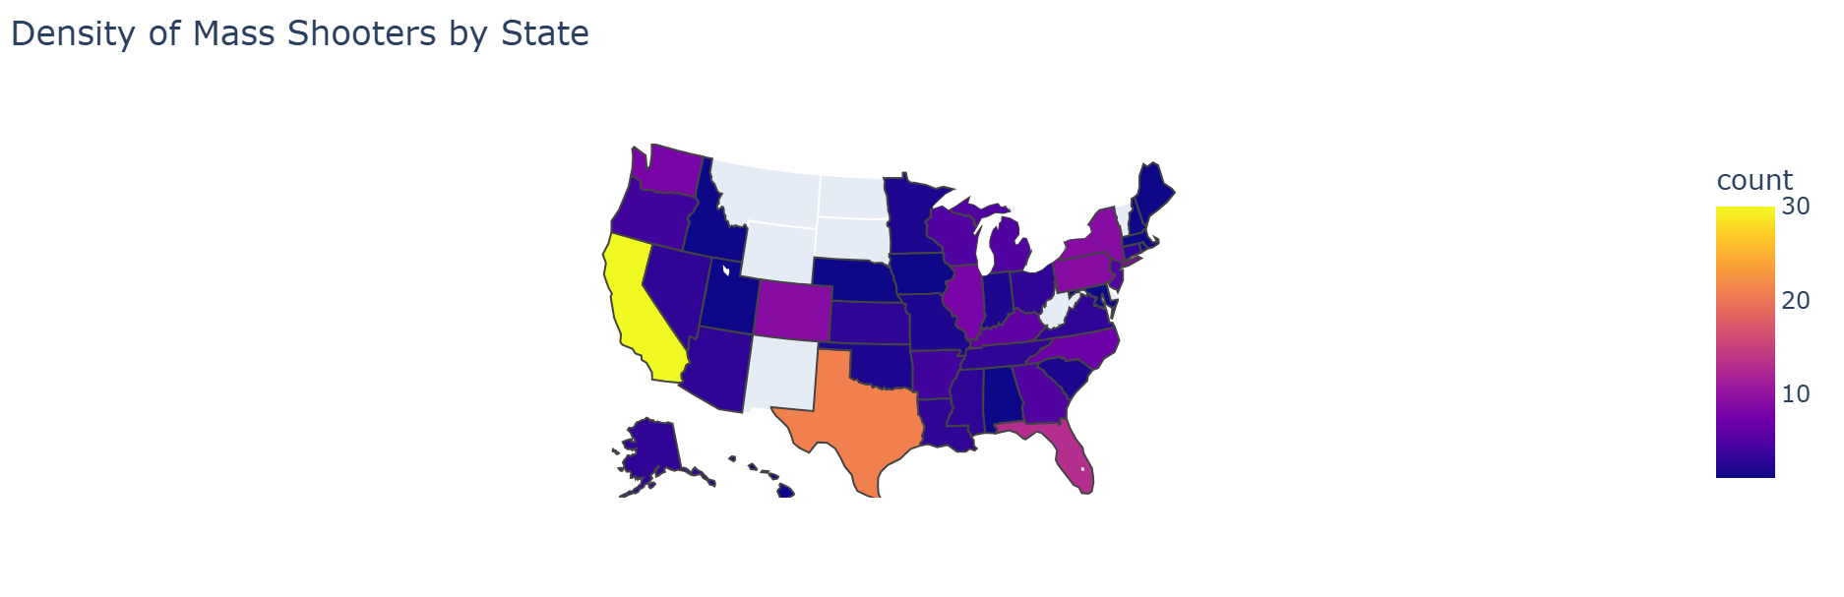
Exploring the Data
Notes:
The number of incidents per state varies significantly, likely influenced by the size and population of each state. Notably, there are seven states—Montana, Wyoming, New Mexico, South Dakota, North Dakota, West Virginia, and Vermont—that have no incidents represented in this data. Conversely, states with larger populations tend to experience more incidents, such as New York, Pennsylvania, Illinois, Colorado, and Washington. Among all states, Florida, Texas, and California stand out, respectively, with the highest number of incidents. This pattern highlights the correlation between population density and the frequency of these events, underscoring the need for targeted prevention strategies in higher-population areas.

Slide 5
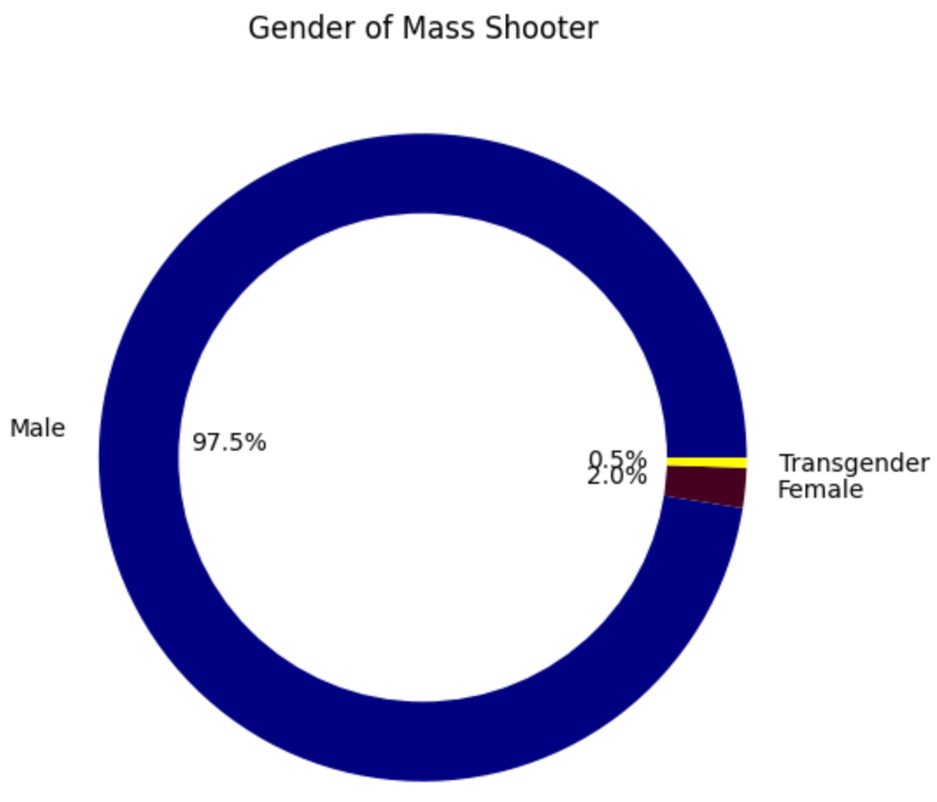
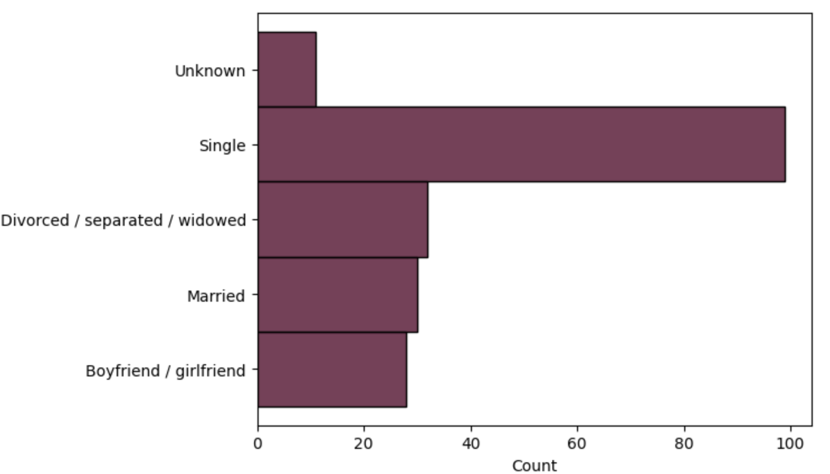
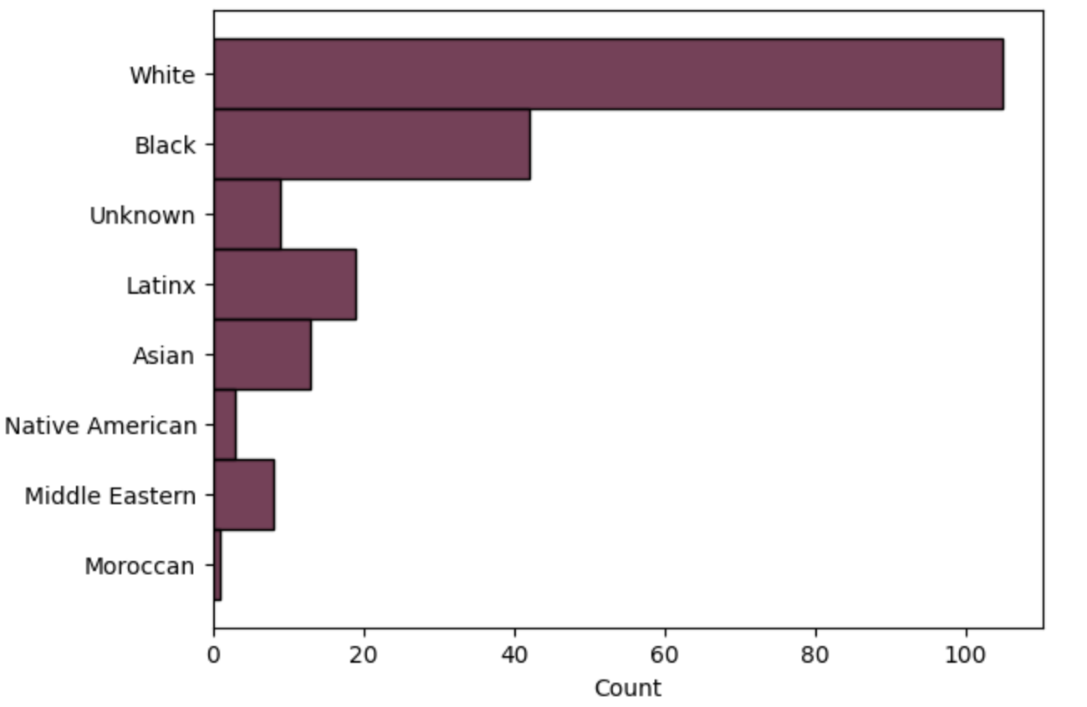
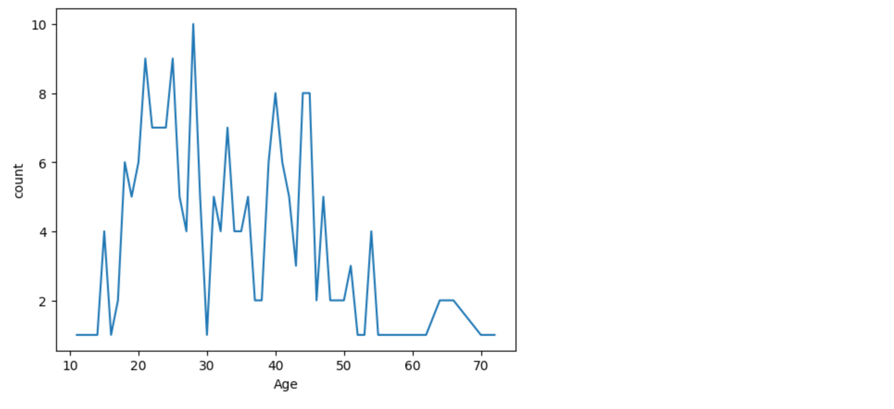
Demographics
Notes:
While there is some variation in marital status and race, the majority of perpetrators are single, white men. Notably, less than 3% of the shooters were female or transgender, highlighting the overwhelming male dominance in these incidents. Age, however, displays a much broader spectrum, with perpetrators ranging from adolescents to the elderly. Interestingly, there are notable spikes in incidents among individuals in their 20s and 40s, suggesting key age groups that may warrant further focus when analyzing potential risk factors or patterns in violent behavior. This demographic diversity underlines the complexity of these situations and challenges us to look beyond surface-level characteristics when understanding motivations and predictors.

Slide 6
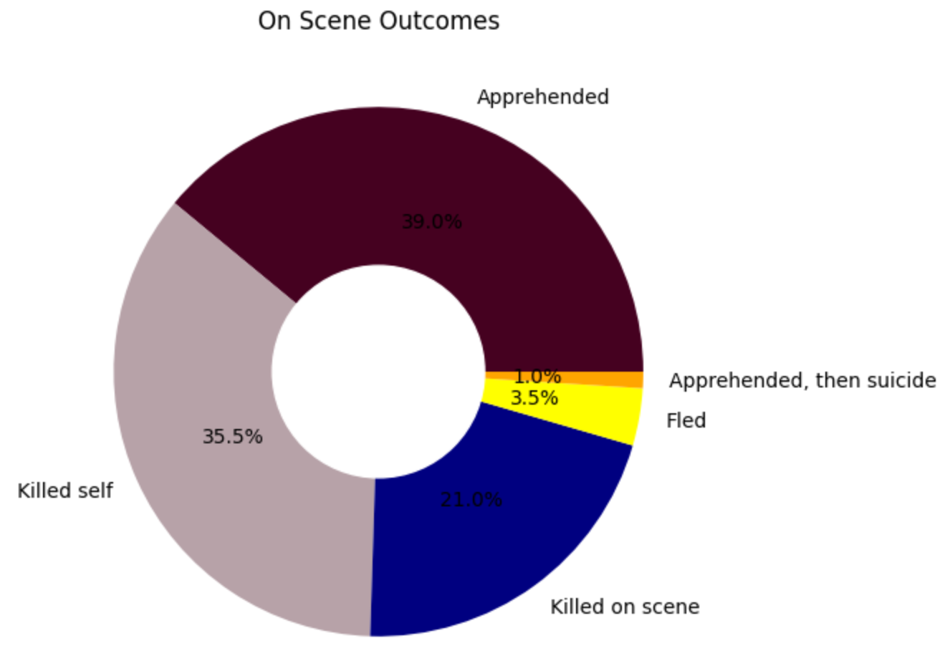
On Scene Outcomes
Notes:
Understanding on-the-scene outcomes is crucial for law enforcement in these situations. The data reveals a range of outcomes: 39% of perpetrators were apprehended by authorities, while 35.5% took their own lives before they could be captured. Another 21% were killed at the scene, either by law enforcement or due to the nature of the incident itself. A smaller percentage, 3.5%, managed to flee the scene, evading capture in the immediate aftermath. Additionally, 1% of those apprehended went on to commit suicide before they could stand trial. These outcomes not only shed light on the immediate response to such crises but also inform law enforcement strategies in future situations, providing insights into potential risks and actions to be taken in the heat of the moment.

Slide 7
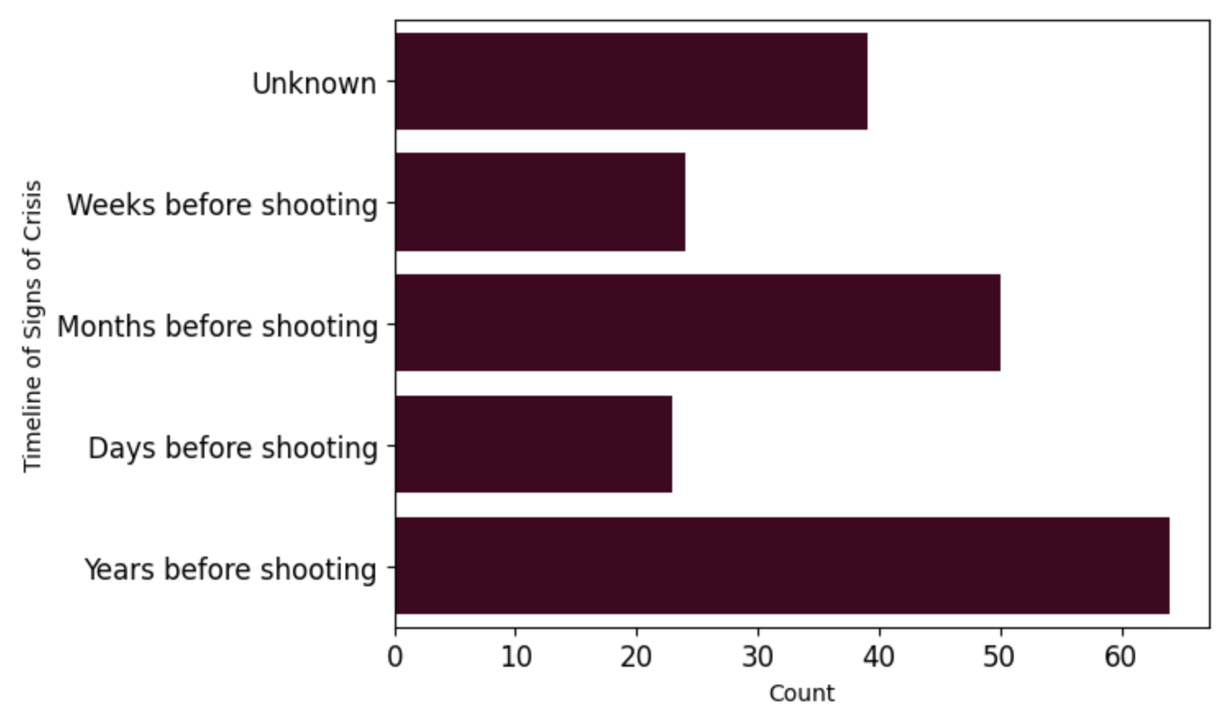
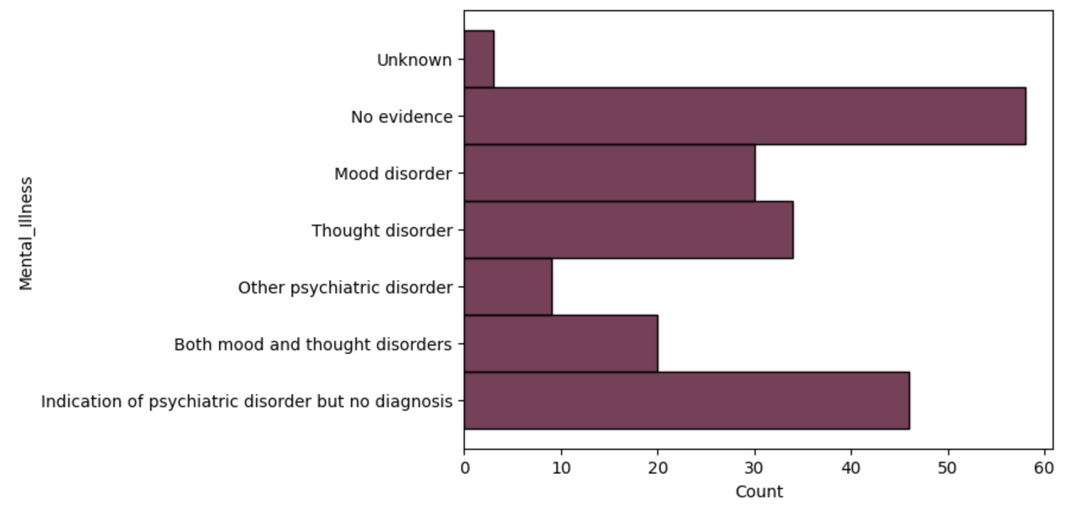
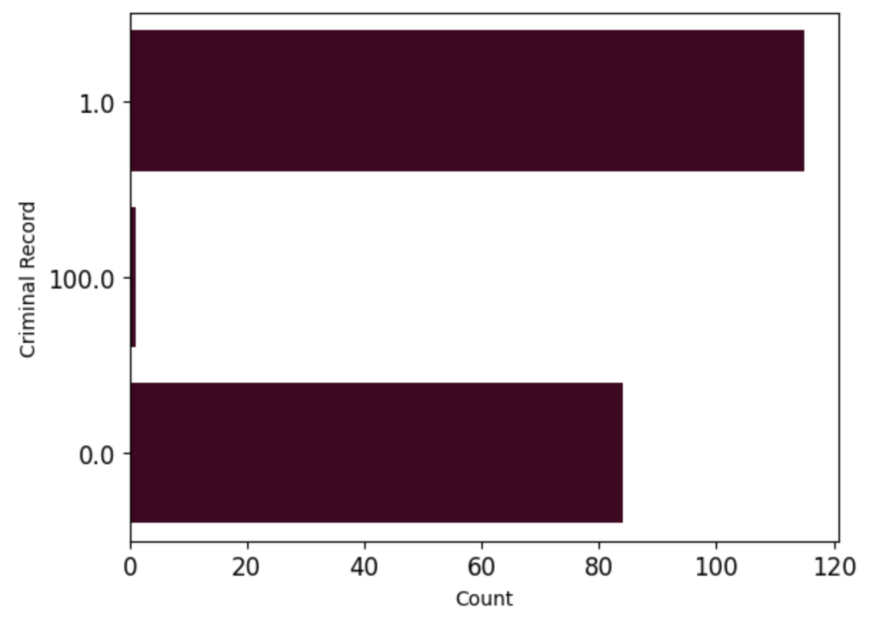
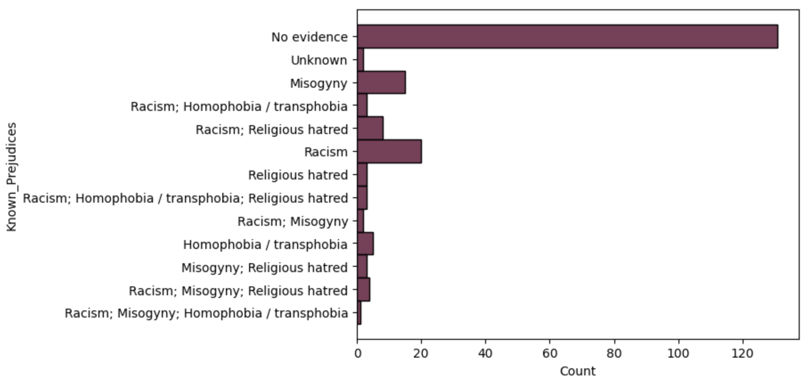
Unexpected Patterns
Some mass shooters exhibit clear warning signs; others do not. Timelines can vary widely
Mental health is a factor, but many perpetrators show no evidence of mental disorders.
Prior criminal activity appears in the data often, however, is still not a great indicator.
The majority also have no known prejudices correlating to their victims.
*100 indicates unknown
Notes:
One of the most striking findings in this data is that there is no single predictor of mass shootings. While factors like mental health issues, prior criminal activity, and personal crises are commonly observed, not every case fits these patterns. Some perpetrators exhibit clear warning signs, while others show no visible indicators of impending violence. The timelines of these incidents can vary greatly, with some individuals potentially showing no signs of crisis at all. Although mental health is often cited as a contributing factor, many mass shooters display no evidence of mental disorders.
Prior criminal activity is frequently present, yet it remains a weak predictor, as more than 40% of perpetrators had no prior criminal background. Additionally, the majority of perpetrators do not appear to harbor known prejudices against their victims, further complicating efforts to identify at-risk individuals based on these factors alone. This highlights the complexity of mass shootings and the need for a multi-faceted approach when analyzing risk factors and prevention strategies.

Slide 8
Machine Learning Models
Neural Network: Achieved an accuracy of 12.5%.
SVM: Reached 27.5% accuracy.
Random Forest: Improved accuracy to 42.5%.
XGBoost: Highest accuracy at 57.5%, identifying key predictors such as mental health history and prior criminal activity
Notes:
I tested multiple models to see if we could predict incidents based on available data. The best-performing model, XGBoost, reached 57.5% accuracy—not perfect, but better than chance. This shows us that while data can help, it’s not the whole story.

Slide 9
Ethical Challenges
Bias in data collection
The risk of stigmatization
Predictive policing concerns
Notes:
Bias in data collection—and consequently in analysis—is always a concern. During data cleaning, I opted to fill in most of the missing values with "unknown" or assigned a numerical value of 100. You can see this reflected in the data shown earlier. While I could have removed rows with missing data, doing so would have distorted the remaining dataset. I could have also made inferences, like assuming blanks indicated "not applicable," such as with the signs of crisis timeline. However, this would be flawed reasoning—it's impossible to confirm that there were no signs of crisis, but we can confidently state that the timeline was unknown. While data-driven insights can be powerful, they also come with ethical considerations. If we're not cautious, we risk reinforcing biases or unfairly labeling individuals as threats.

Slide 10
What Can We Do?
Support mental health initiatives
Improve intervention strategies
Use data responsibly
Notes:
There’s no simple solution, but we can take steps toward prevention by improving mental health support, refining intervention strategies, and using data responsibly to inform—not dictate—policy decisions.

Slide 11

Learning from the past to build a safer future
Notes:
This research is not about predicting the future with certainty. It’s about learning from the past to build a safer future. Let’s use what we know to drive meaningful change.

Slide 12
Thank You
Sammi Beard

